Slide 1
Low-Pressure IMS Construction: Front Ion Funnel
Clowers Research Group at WSU

Slide 2
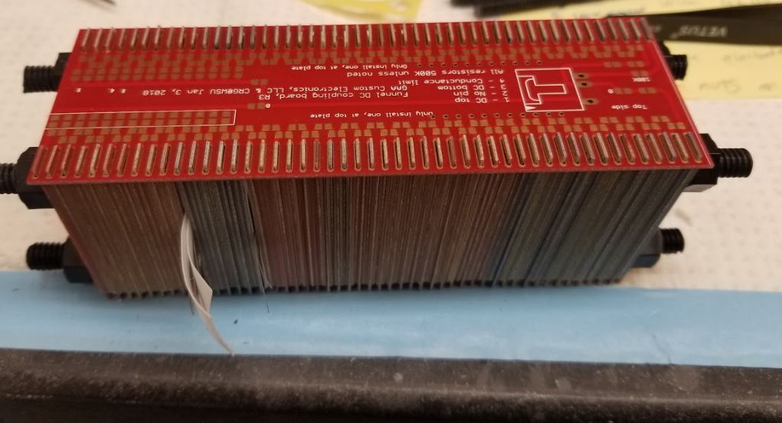
Front Funnel
Resistors are soldered into place, new funnel top board is designed to remove need for special resistors.
Electrodes are soldered into place after careful alignment.
Ensure any ion gates are in line (grid pattern overlaps cleanly)
Adding spacers (~6) on either end of funnel helps to not compress the electrodes during soldering assembly.
When applying the Molex in for DC in, out, and Conductance limit. Remove any unused pins from the connector.

Slide 3
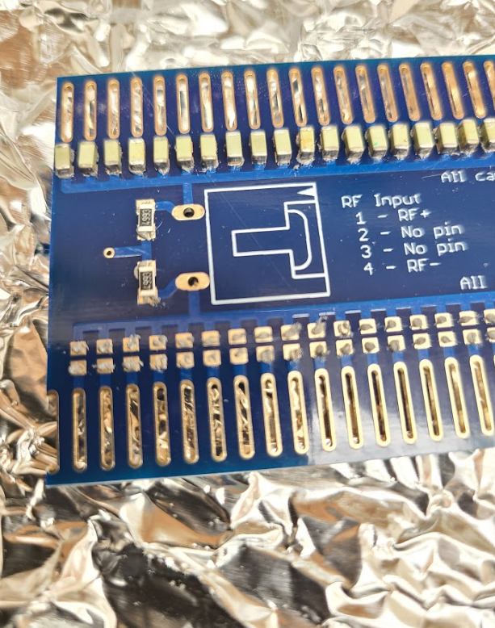
Front Funnel RF Board
Place capacitors carefully, solder electrodes at same time as DC board
Ensure the two resistors are in place (resistors are of same size as DC board)
If funnel is floated, connect a wire from middle of the DC board to the marked spot on the photo
When applying the Molex in for RF in and RF out, remove any unused pins from the connector.

Slide 4
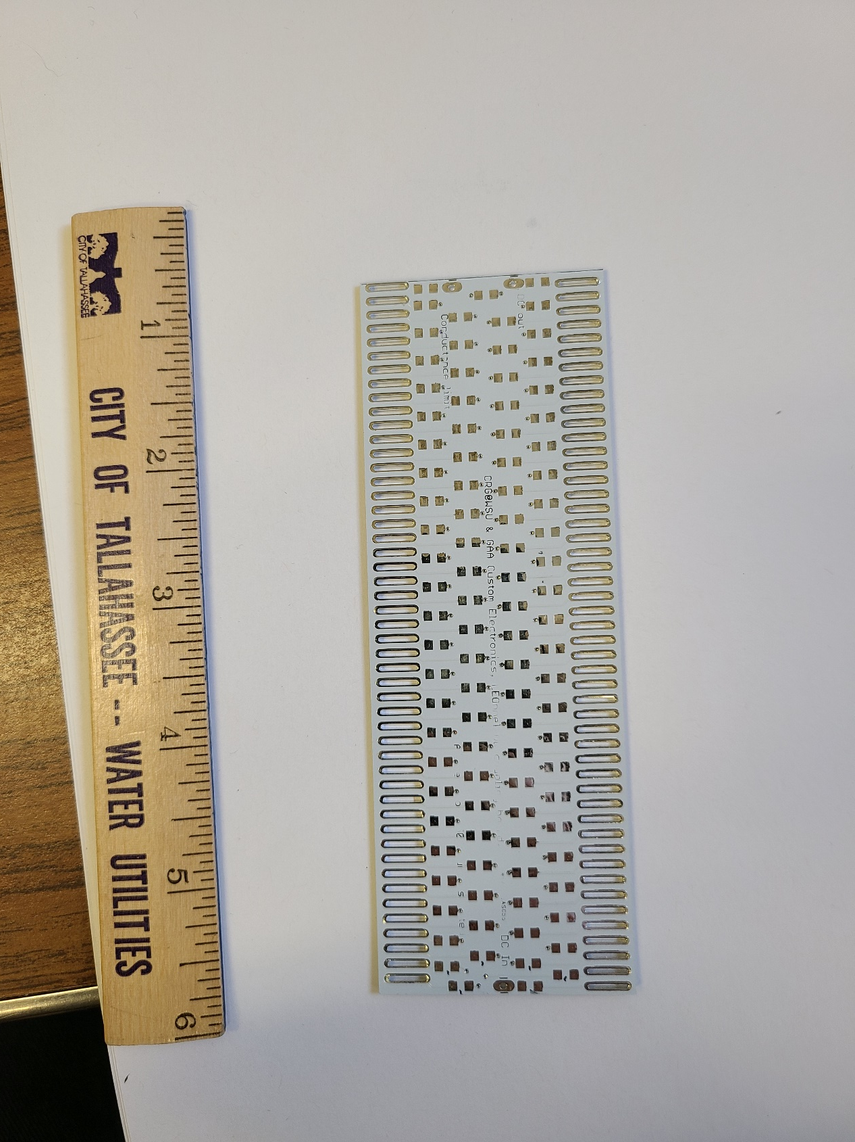
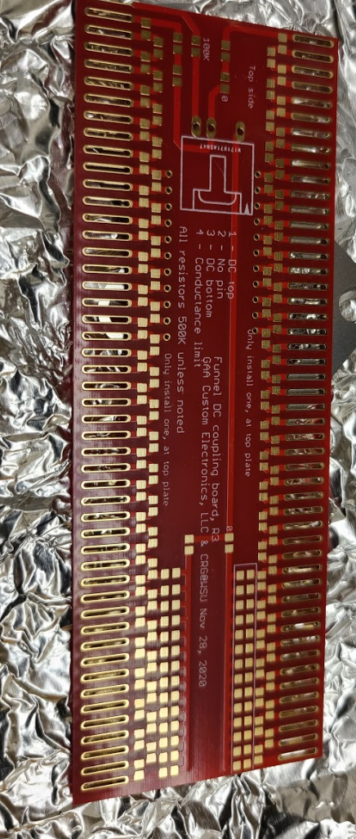
Front Funnel DC Board
1.
3.
2.
Old board requires resistors of variable value in order to maintain correct voltages on both sides at marked locations.
1.= 100 kΩ
2.= 0 Ω
3.= 250 kΩ
4.= 0 Ω
5.= 250 kΩ
New board all resistors are the same.
5.
4.

Slide 5
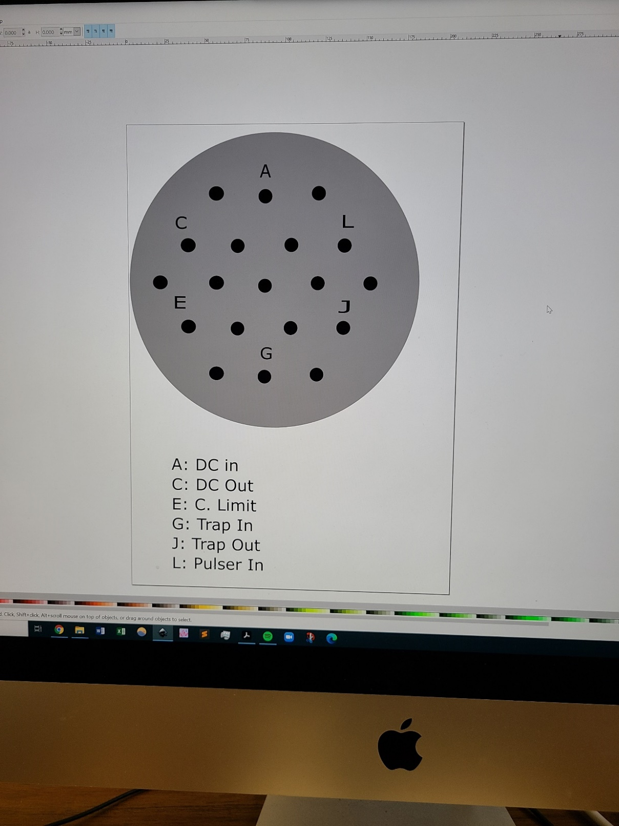
Front Funnel Electrical Connections
Representative connections will change depending on electrical connectors used
This schematic was for the original ion trap funnel that was designed
Utilization of different configurations will change electrical connections, ensure proper documentation during assemble of electrical components.

Slide 6
Low-Pressure IMS Construction: Ion Funnel Testing
Clowers Research Group at WSU

Slide 7
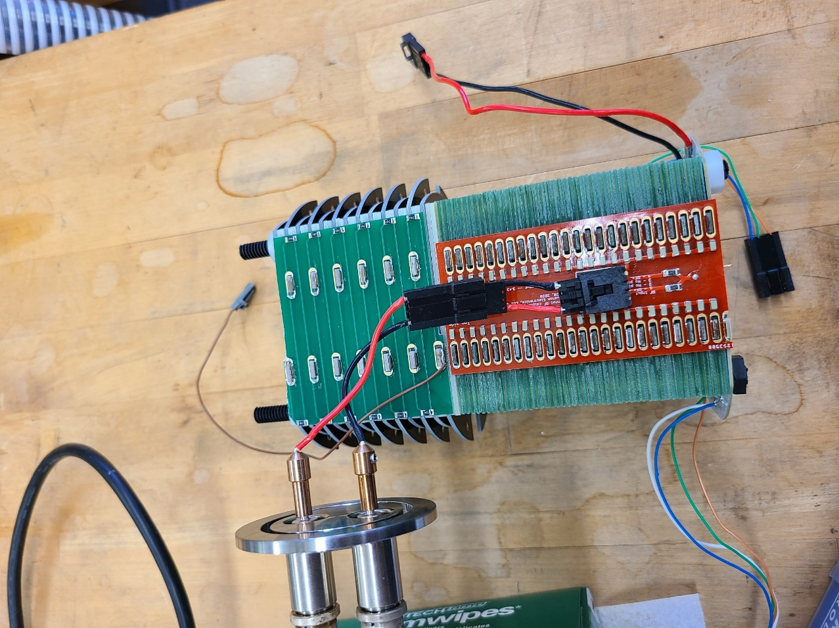
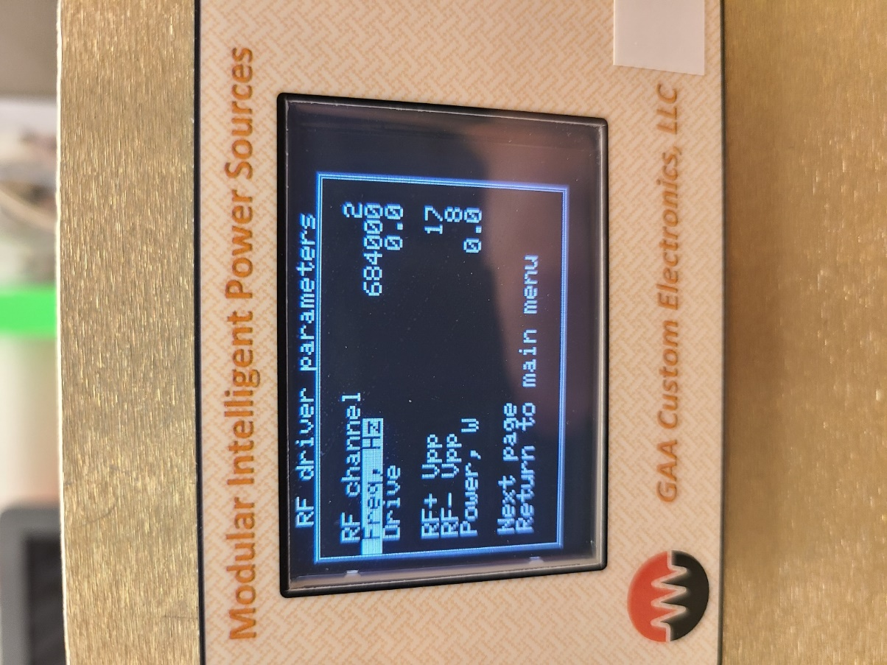
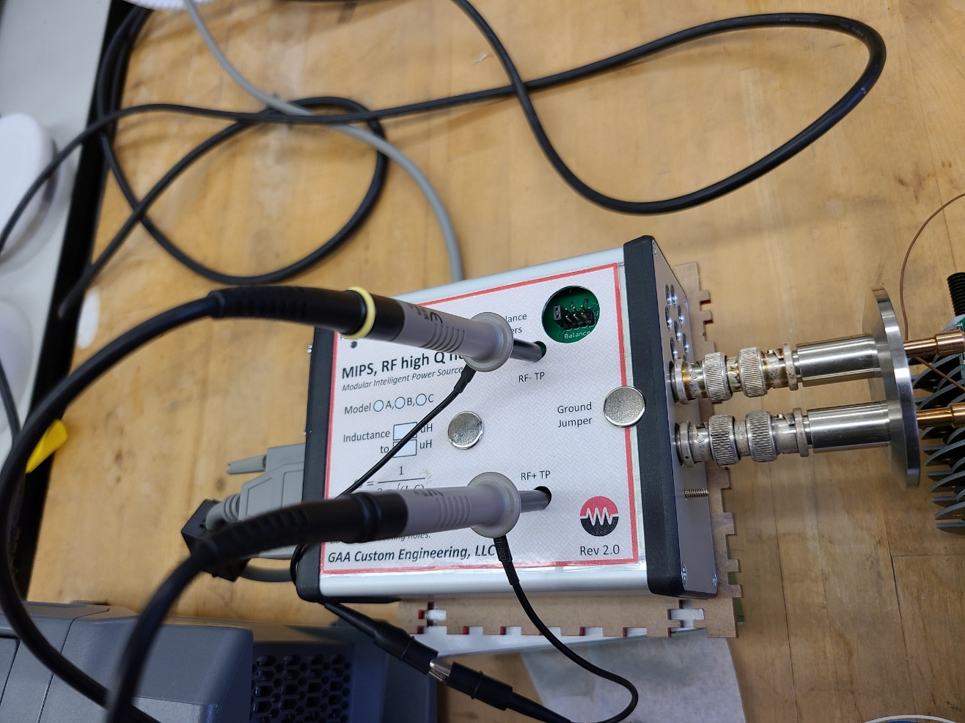
Ion Funnel Testing
Rear and Front ion funnel tested the same way
Using the MIPS RF channel readout, ensure the drive is zero before connecting anything.
On Benchtop, connect the RF power feeds to the RF quad driver (High Q head)
Connect oscilloscope probes (10x attenuation ONLY) to testing points. Scale trigger levels and ensure voltage scale for the two channels are identical

Slide 8
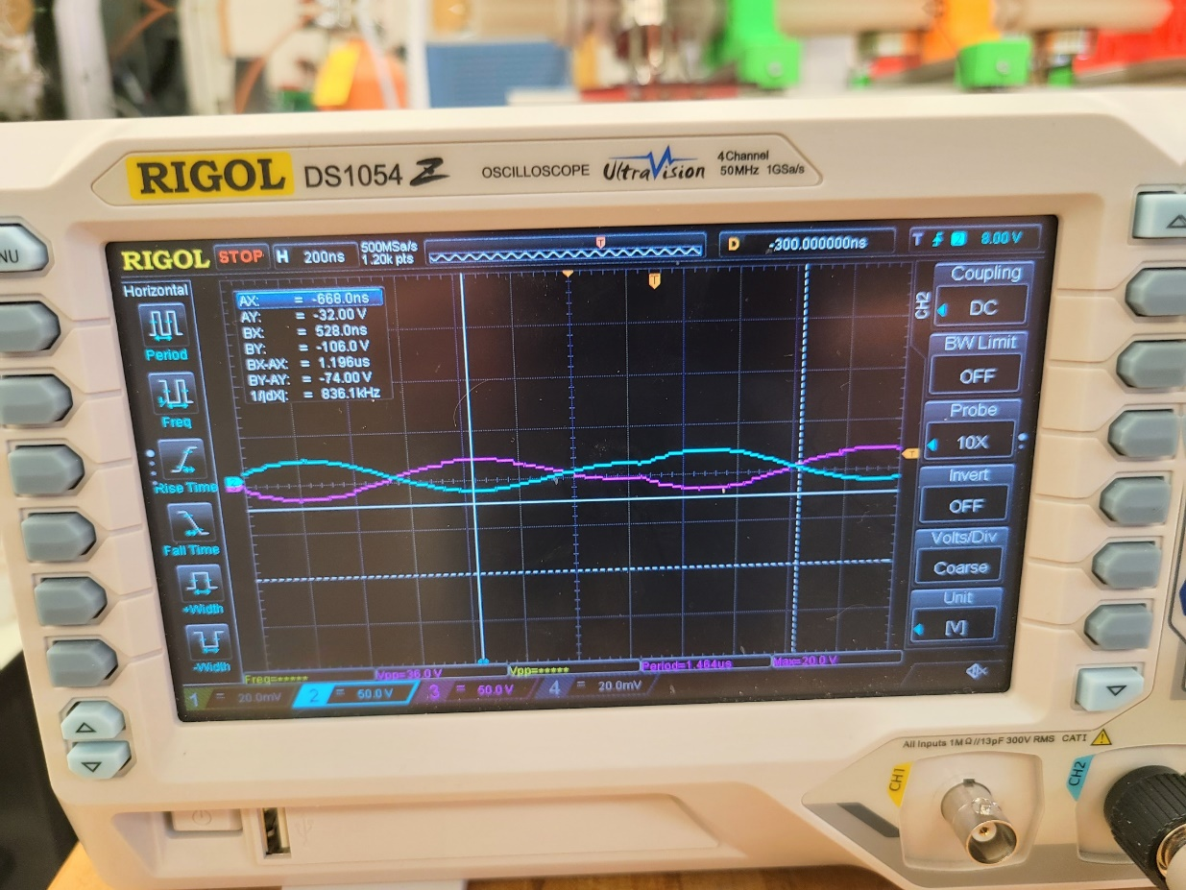
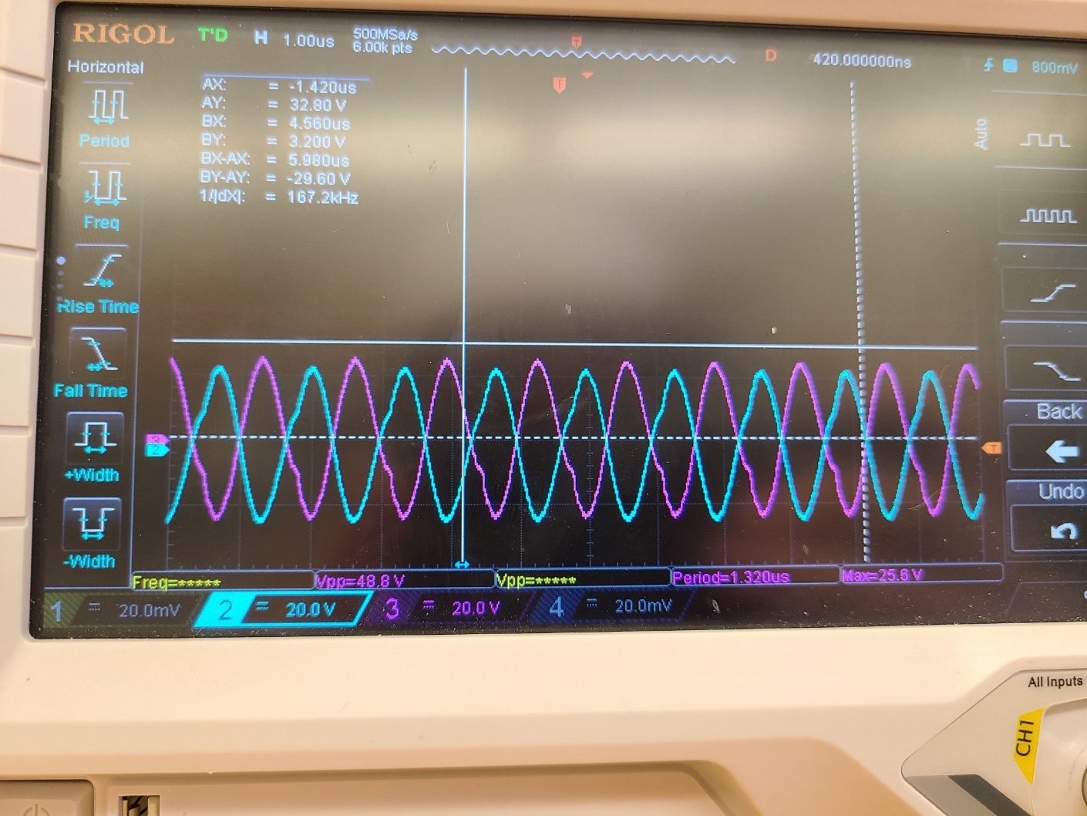
Ion Funnel Testing
Rear and Front ion funnel tested the same way
Using the MIPS RF channel readout, apply a drive of about 20, which should be about 150 volts RF P2P
Change the frequency of the system until the two traces are in relative alignment. Most likely between 750 kHz to 1 MHz
Upper trace is at low RF and non resonant frequency.
Lower trace is at correct frequency and RF voltage

Slide 9
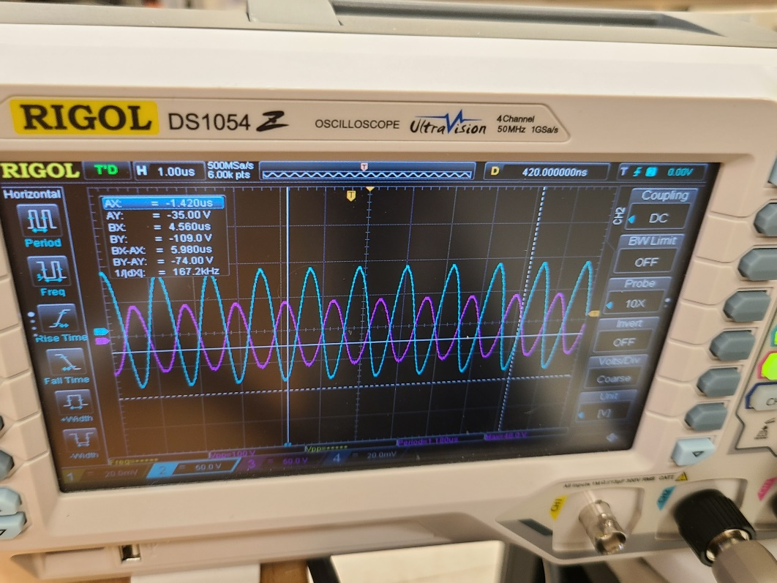
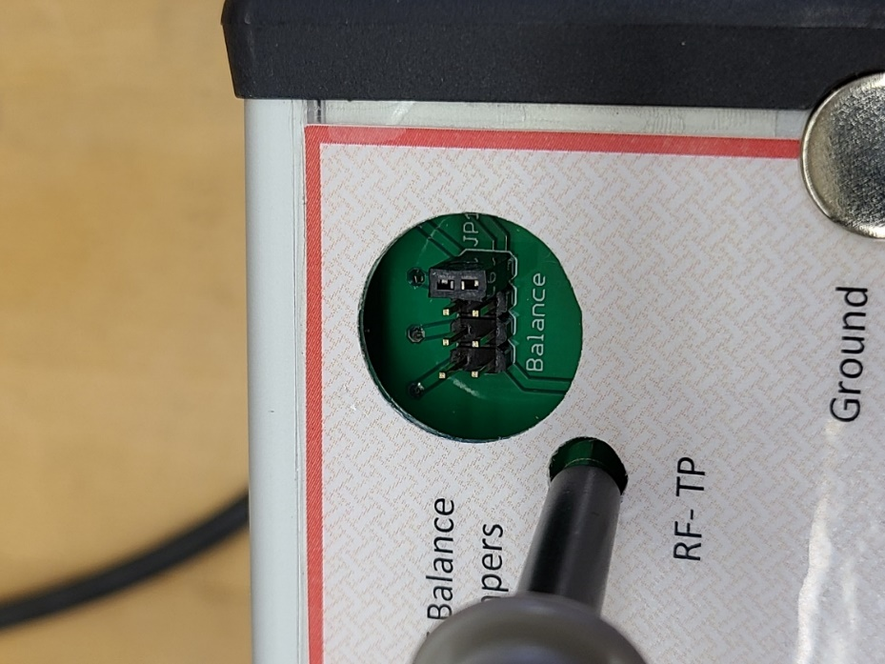
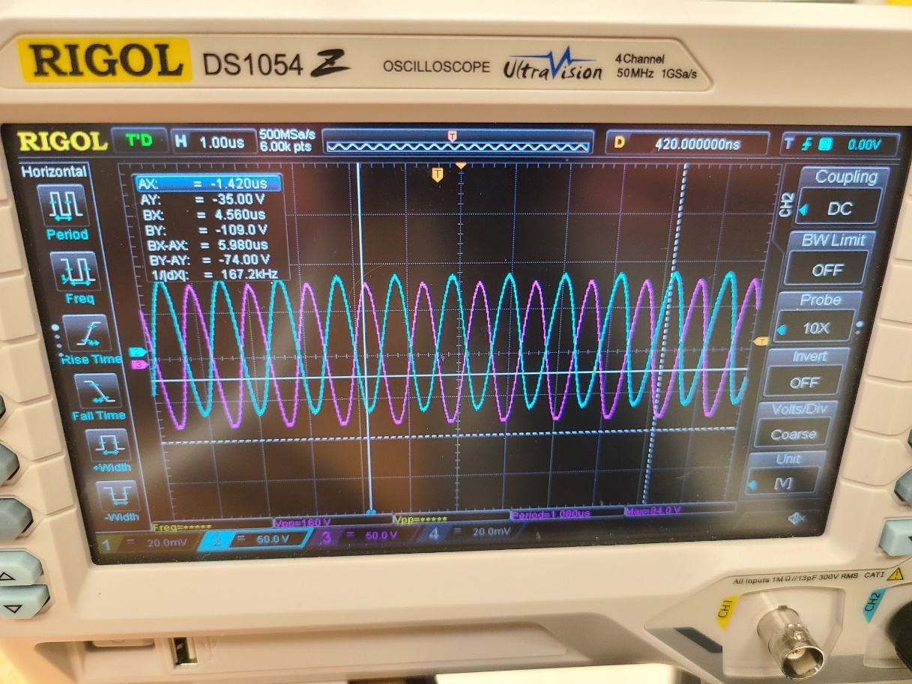
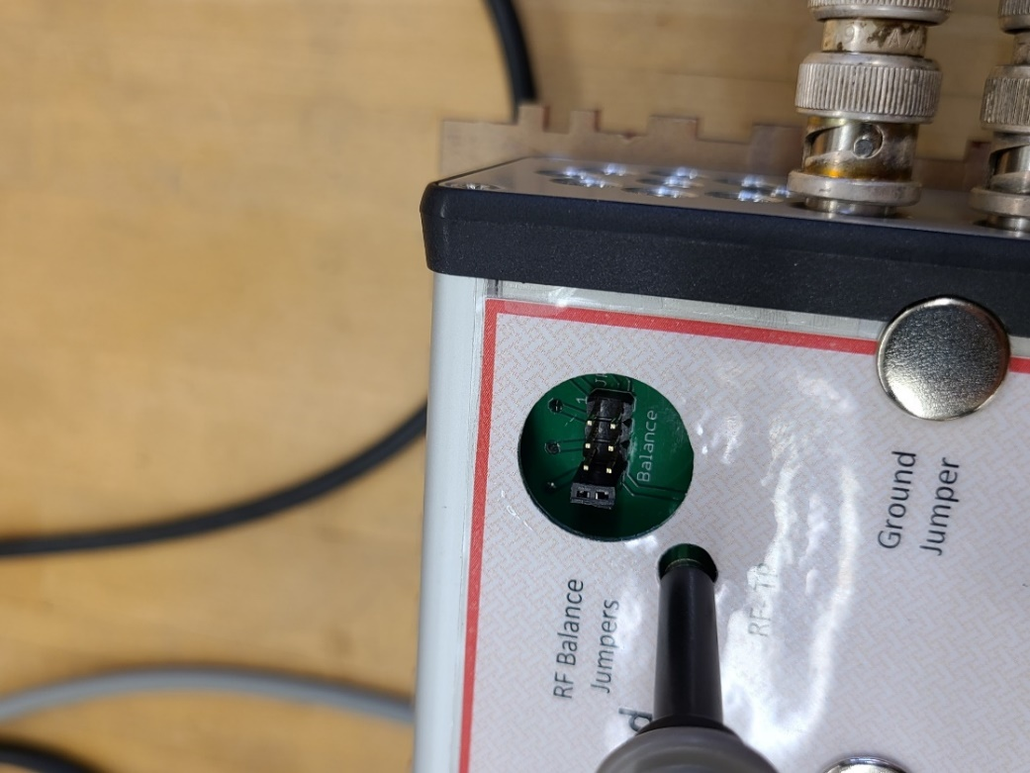
Ion Funnel Testing
Rear and Front ion funnel tested the same way
After finding resonant frequency, turn off RF power and adjust the jumper to a different spot if needed
Location of jumper might change resonant frequency slightly. Adjust frequency until the two traces are near identical
If traces are unable to be in alignment, check wire connectors, BNC connectors, RF feedthrough ports, and all connections on funnel

Slide 10
Low-Pressure IMS Construction: Rear Ion Funnel
Clowers Research Group at WSU

Slide 11
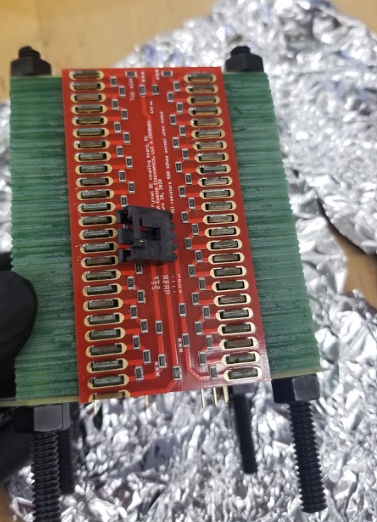
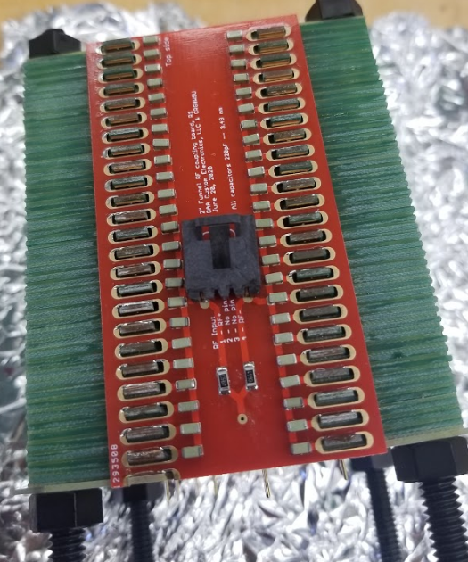
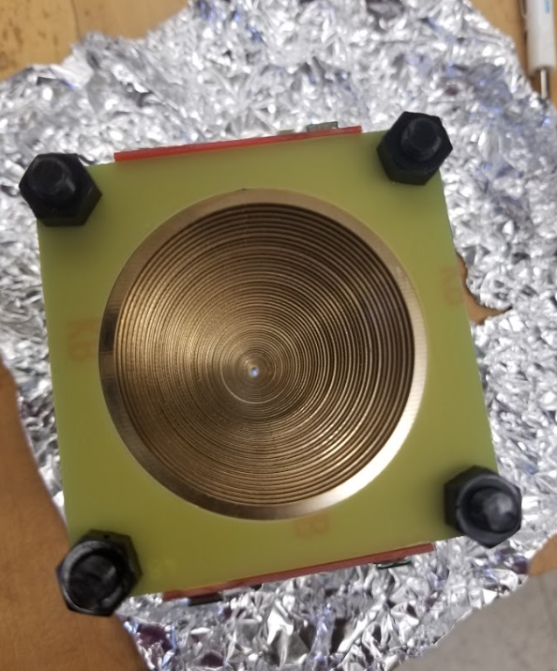
Rear Funnel Construction
Assemble the rear ion funnel the same way as the front ion funnel
Note that the DC board has the same resistor deviances as the front funnel
Test the same as front funnel

Slide 12
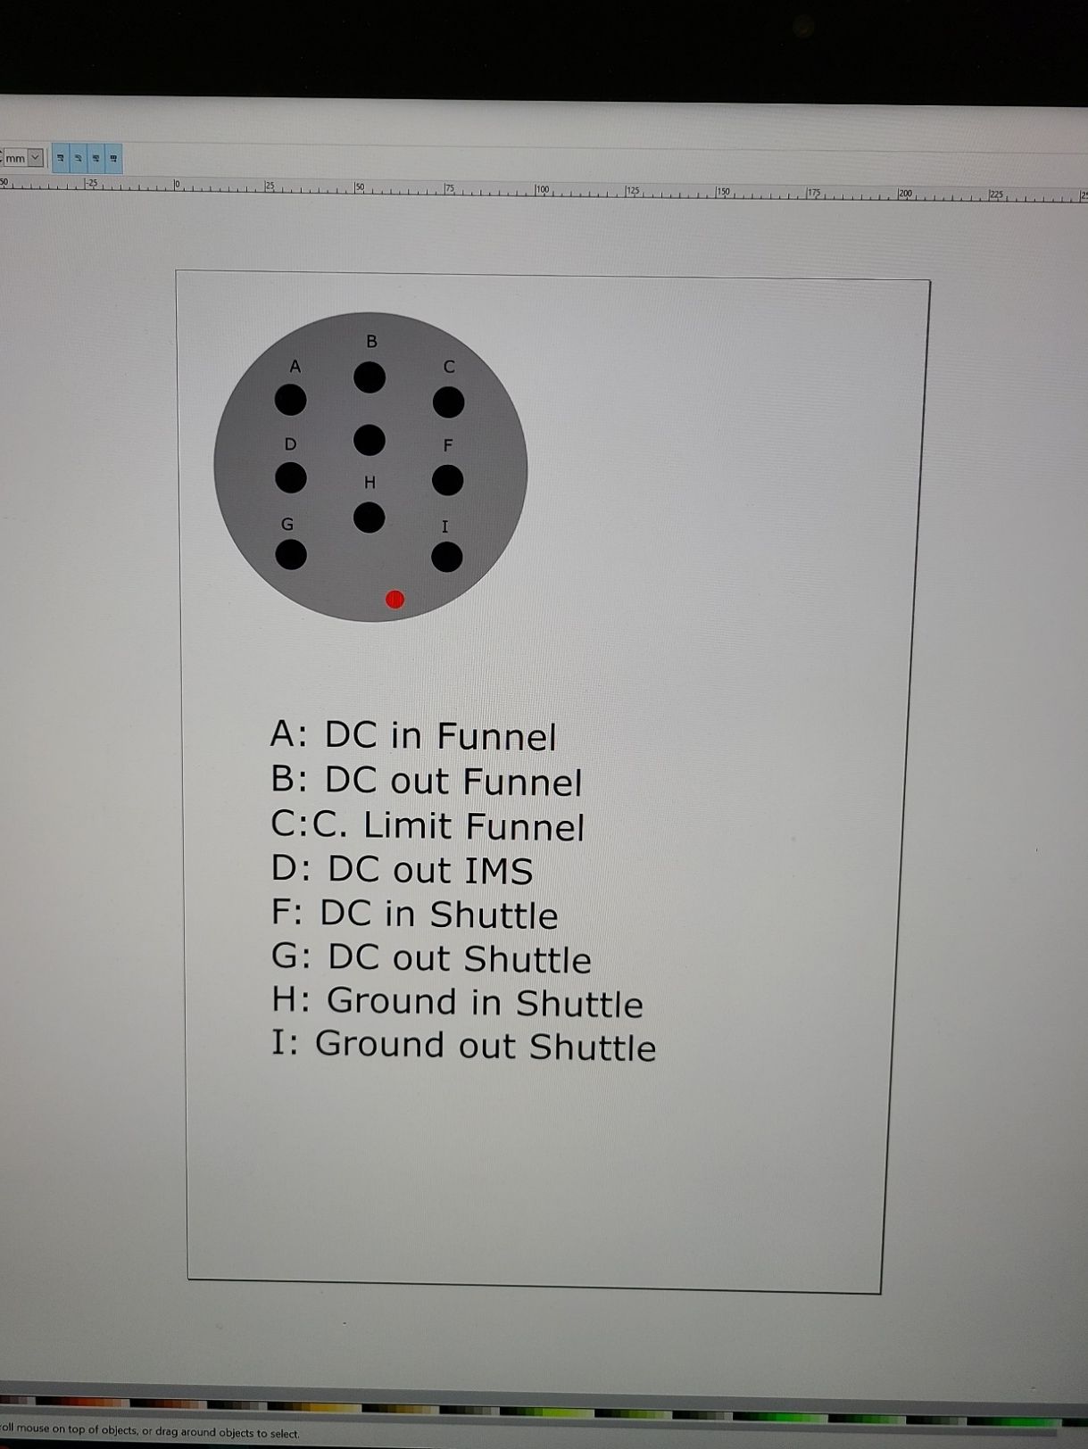
Rear Funnel Electrical Connections
Representative connections will change depending on electrical connectors used
This schematic was for the original rear ion funnel and Ion Shuttle configuration

Slide 13
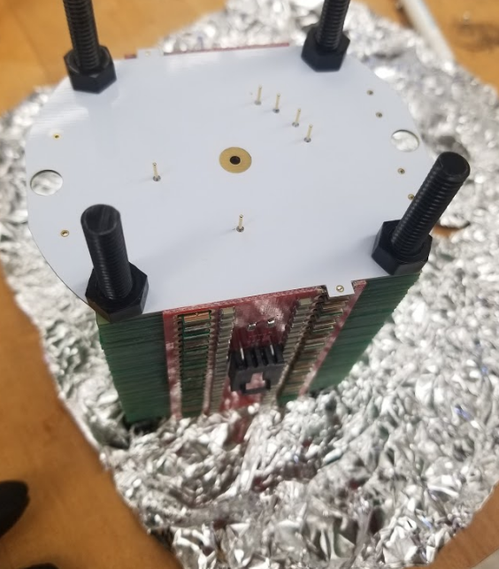
Rear Funnel
The Rear ion funnel used with a Faraday plate is NOT compatible with the ion shuttle.
The ion shuttle ion funnel has these connectors in place (shown on image)
We built a second ion funnel which does not have these pins to use with a Faraday Plate. When we utilize the ion shuttle we will switch funnels for the ones with these connectors.

Slide 14
Low-Pressure IMS Construction: Ion Funnel Current Testing
Clowers Research Group at WSU

Slide 15
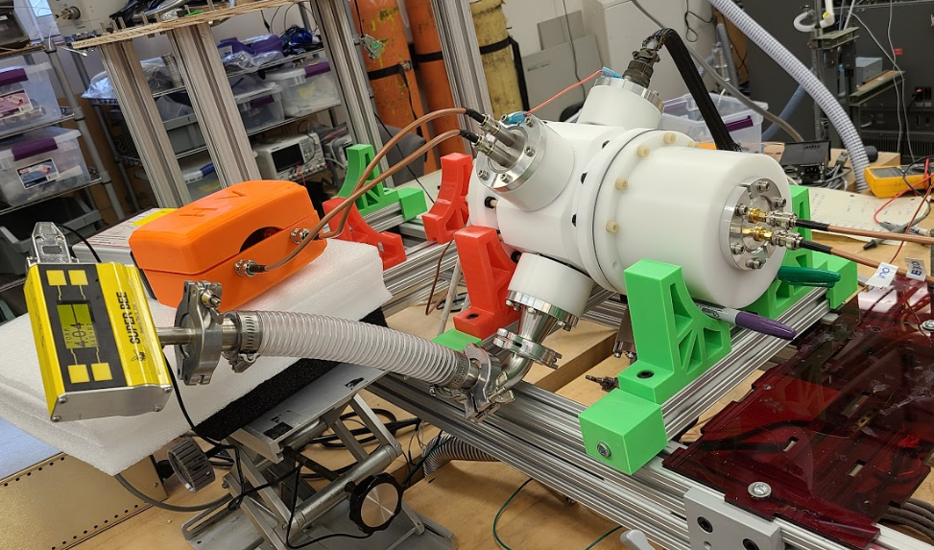
Front Funnel
Testing the ion current with just the front ion funnel, and the faraday plate. (Structural support sharpies are recommended, but not required)
An ESI needle was placed at the inlet capillary and total ion current was measured.

Slide 16
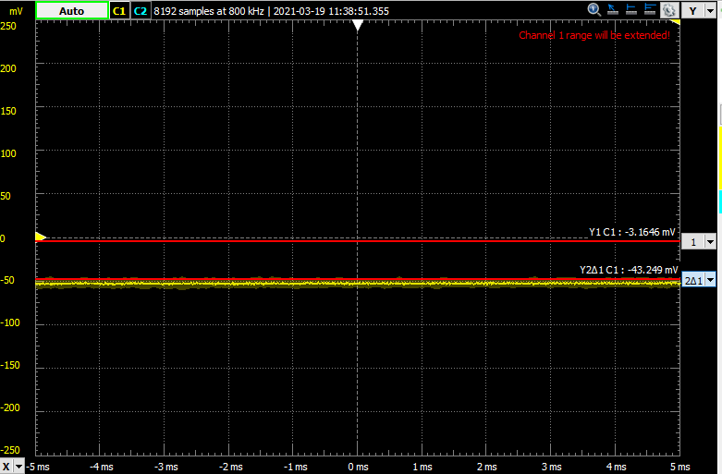
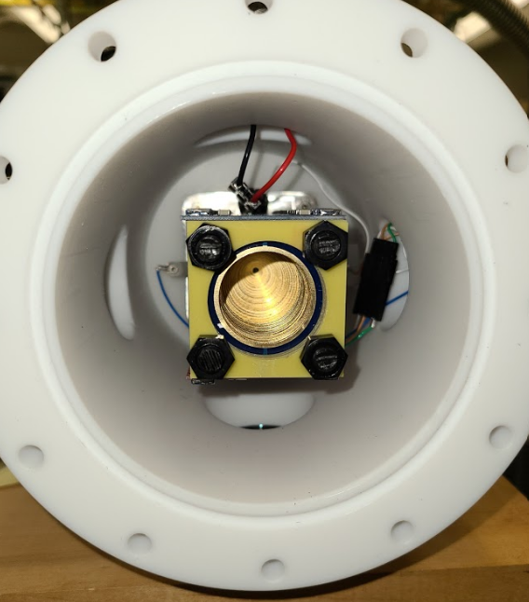
Front Funnel ION CURRENT
Red line at zero is baseline current, ESI solvent (80:20:0.1% MeOH, Water, Formic Acid) was electrosprayed
Faraday plate was placed at the end of ion funnel
Positive ions induce a negative recorded current.

Slide 17
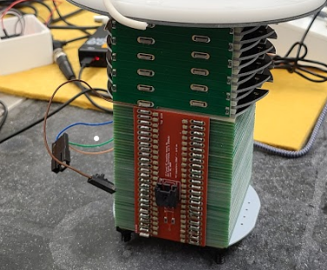
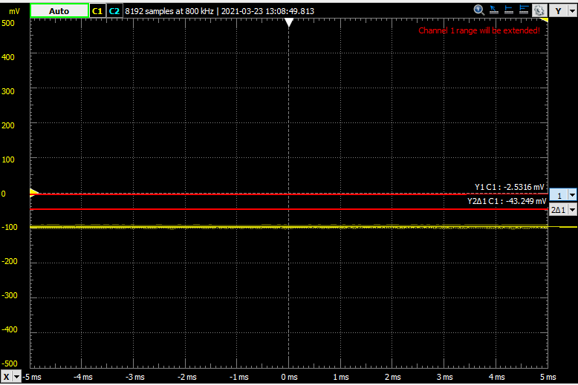
Rear Funnel
Add ~20 V cm⁻¹ DC field to IMS portion by applying DC in and DC out to IMS
Test the Rear Ion Funnel the same as the Front ion Funnel. Set DC in Funnel to be about 15 volts lower than IMS DC out

Slide 18
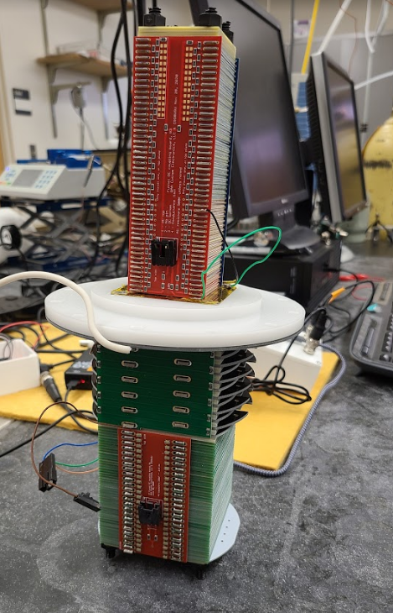
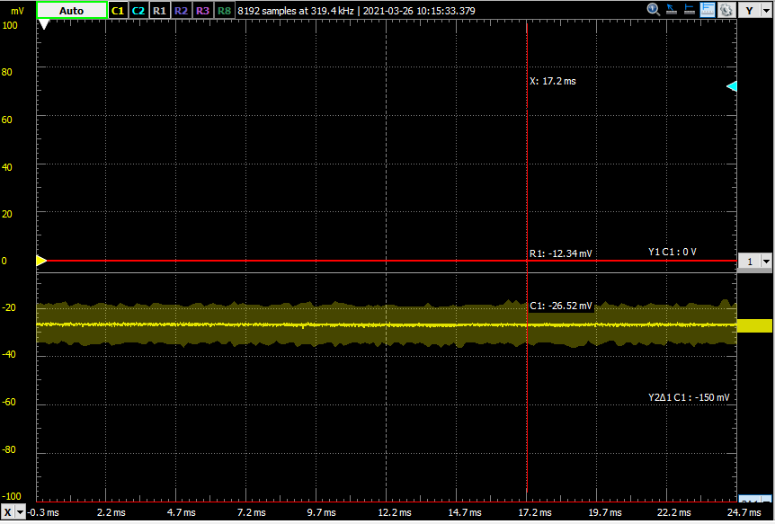
Testing Funnel Ion Current
Both ion funnels were used in tandem to ensure ion current.
Creative modifications to vacuum lines, pressure gauges, and electrical connections are required to ensure connections and successful operation
Ensure that the front chamber has a slightly higher (~0.1 Torr) than the rear chamber or ion current will not be observed.
Same testing parameters as for individual funnel

